Slide 1
Outline
n Importance of Project Schedules
n Six Main Processes
1. Planning Schedule Management
2. Defining Activities
3. Sequencing Activities
4. Estimating Activity Durations
5. Developing the Schedule
6. Controlling the Schedule
n Using Software to Assist in Project Schedule Management
2

Slide 2


5. Developing the Schedule
n Schedule development uses the results of the first four project schedule management processes to determine the start and end dates ofthe project and its activities
Goal: create a realistic project schedule that provides a basis for monitoring project progress for the time dimension of the project
Main outputs: a schedule baseline, project schedule, schedule data, project calendars, change requests, PM plan and project documents updates
n Four important tools and techniques
i. Gantt chart: a common tool for displaying project schedule information
ii. Critical path analysis: an important tool for developing and controlling project schedules
iii. Critical chain scheduling: a technique focusing on limited resources when creating a project schedule
iv. PERT analysis: a means for considering schedule risk on projects
3

Slide 3






Gantt Charts (1 of 3)
n Gantt charts provide a standard format for displaying project schedule
information by listing project activities and corresponding start and finish dates in a calendar form
Sometimes referred to as bar charts because the start and end dates of activities are shown as horizontal bars
Figure 6-5 shows a Gantt chart for Project X in Figure 6-2 created by using Microsoft Project. Figure 6-6 shows a more sophisticated Gantt chart for a software lunch project.
n Different symbols on Gantt chart in Figure 6-6
Black diamond represents a milestone
Thick black bars with rectangles at the beginning and end represent
summary tasks
Light blue bars for tasks 2 to 5 represent the durations of these tasks
Arrows show relationships or dependencies between tasks
4

Slide 4
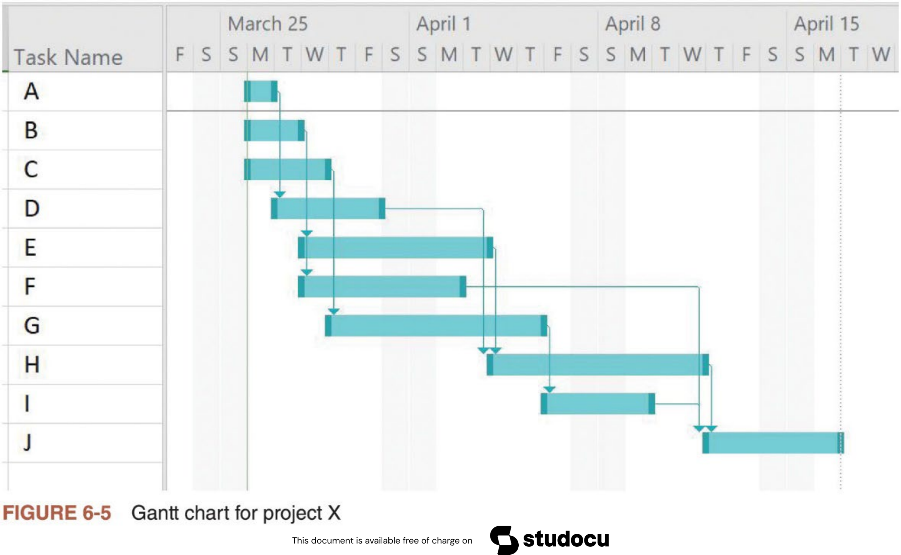
Gantt Charts (2 of 3)
5

Slide 5
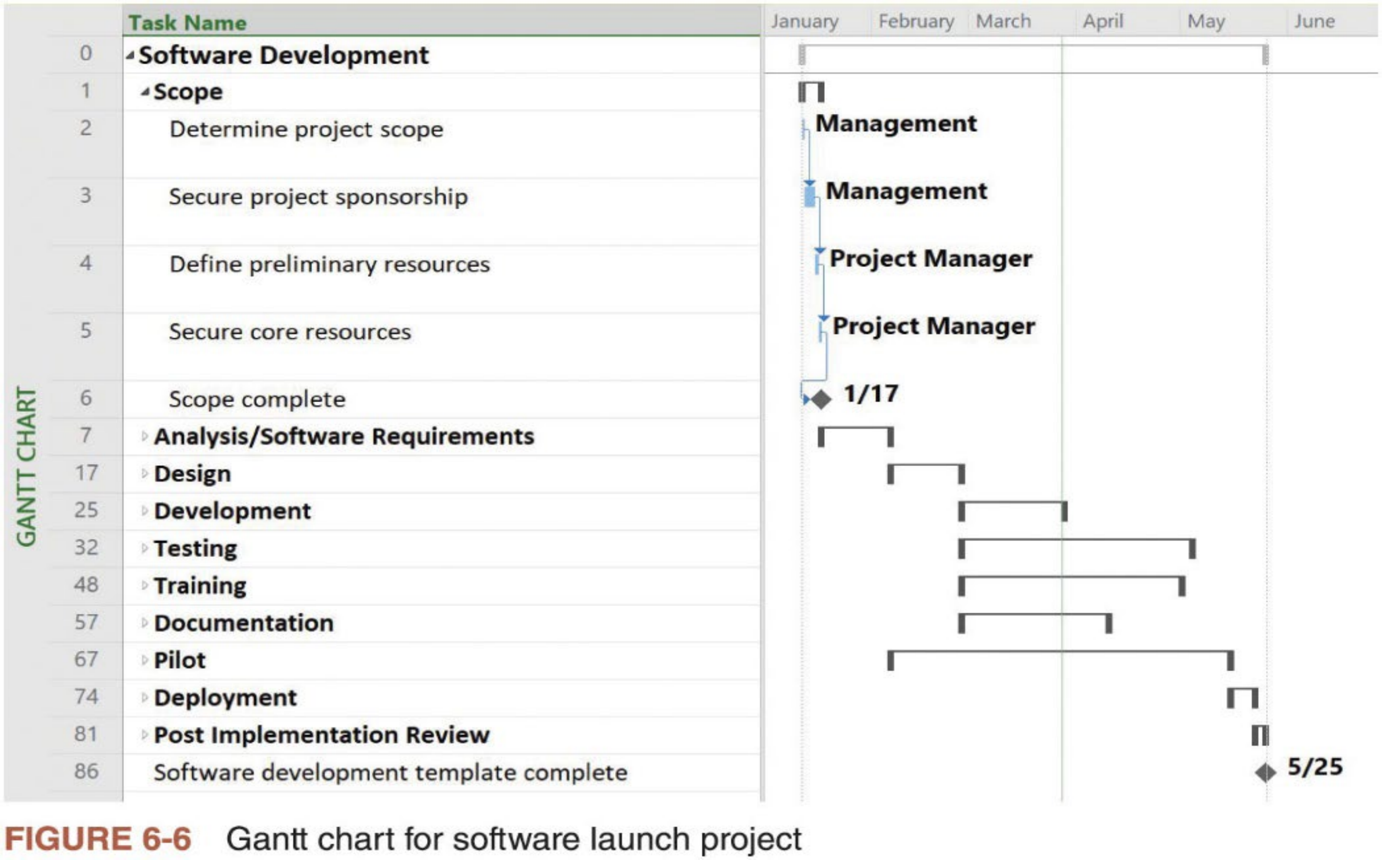
Gantt Charts (3 of 3)
6

Slide 6



Adding Milestones to Gantt Charts
n Milestones are created to emphasize important events or accomplishments on projects
Created by entering tasks with zero duration
In Microsoft Project, you can mark any task as a milestone by checking the box for “Mark task as milestone” in the Advanced tab of the Task
Information dialog box
n SMART criteria for creating meaningful milestones (or goals)
i. ific: target a specific goal
ii. Measurable: target a quantifiable goal
iii. Assignable: specify who will do it and be responsible for the actual delivery
iv. Realistic: be realistically achievable, given available resources
v. Time-bound: specify a deadline before which the milestone must be achieved
7

Slide 7
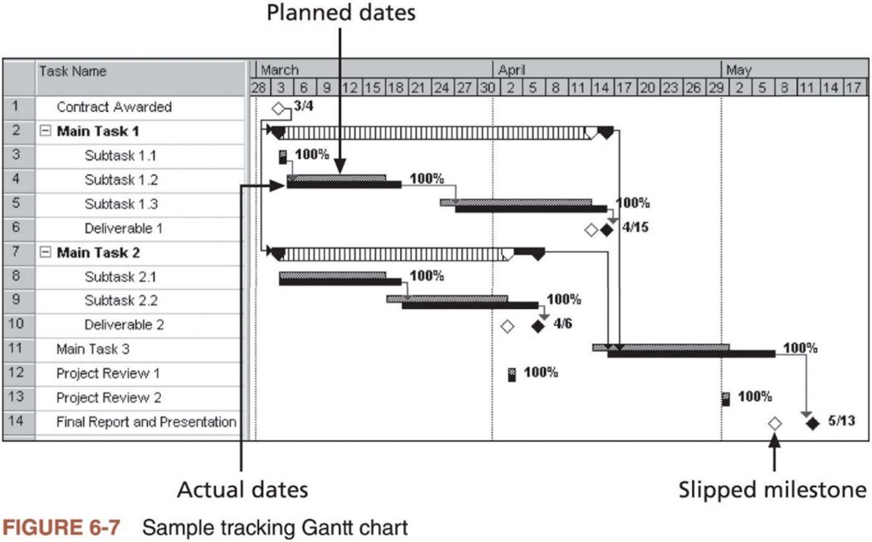
Using Tracking Gantt Chart to Compare Planned and Actual Dates (1 of 2)
n Tracking Gantt chart is a Gantt chart that compares planned and actual project schedule information
8

Slide 8



Using Tracking Gantt Chart to Compare Planned and Actual Dates (2 of 2)
n A tracking Gantt chart uses a few additional symbols:
The tracking Gantt chart in Figure 6-7 often shows two horizontal bars for
tasks. The top horizontal bar represents the planned or baseline duration for each task. The bottom bar represents the actual duration.
A striped horizontal bar, as illustrated by Main Tasks 1 and 2, represents the planned duration for summary tasks. The black bar adjoining it shows
progress for summary tasks.
A white diamond represents a slipped milestone (i.e., a milestone which was completed later than originally planned).
Percentages to the right of the horizontal bars display the percentage of work completed for each task
n A tracking Gantt chart allows the project manager to monitor schedule progress on individual tasks and the whole project
9

Slide 9


Critical Path Method (CPM) (1 of 3)
n CPM, also called critical path analysis, is a network diagramming technique used to predict total project duration
n A critical path for a project is a series of activities that determine the earliest time by which the project can be completed
The longest path through the network diagram with the least amount of slack or float
Slack or float is amount of time an activity may be delayed without delaying a succeeding activity or the project finish date
n Determining the critical path
1. Develop a good network diagram with an estimated duration of each activity
2. Add the durations for all activities on each path through the network diagram (most projects have multiple paths)
3. The longest path is the critical path
10

Slide 10
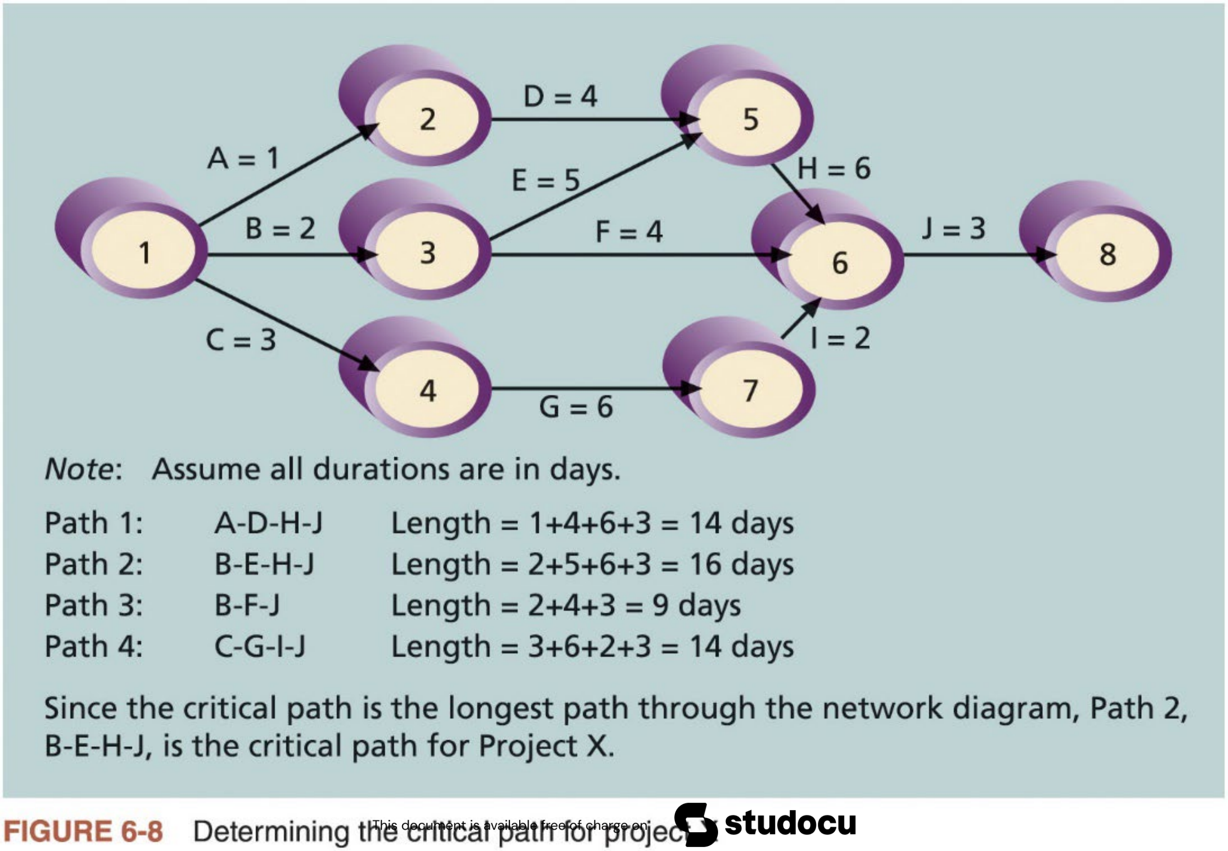
Critical Path Method (CPM) (2 of 3)
11

Slide 11
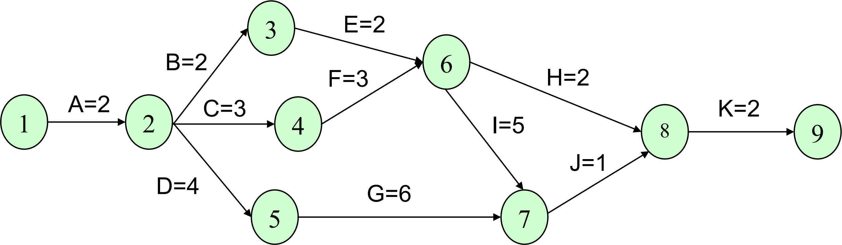
Exercise 3: Critical Path Analysis
n Determine the critical path for the project in Exercise 1, whose AOA network diagram is shown below.
Path 1: A-B-E-H-K Length = 2+2+2+2+2 = 10
Path 2: A-B-E-I-J-K Length = 2+2+2+5+1+2 = 14
Path 3: A-C-F-H-K Length = 2+3+3+2+2 = 12
Path 4: A-C-F-I-J-K Length = 2+3+3+5+1+2 = 16
Path 5: A-D-G-J-K Length = 2+4+6+1+2 = 15
The critical path is Path 4: A-C-F-I-J-K, with the total length 16.
12

Slide 12

Critical Path Method (CPM) (3 of 3)
n What does the critical path mean?
Even though the critical path is the longest path, it represents the shortest time required to complete a project (agree?)
If one or more activities on the critical path take longer than planned, the
whole project schedule will slip unless the project manager takes corrective actions
n Additional remarks
i. The critical path is concerned with the time dimension of a project. The word “critical” does not mean that it includes all critical activities.
ii. A project can have more than one critical path, when two or more paths have the same longest total duration
iii. The critical path on a project can change as the project progresses, if some activities NOT on it take longer than planned to be finished
13

Slide 13


Using Critical Path Analysis to Make
Schedule Trade-Offs (1 of 4)
n Knowing the critical path throughout the life of a project can help project managers make schedule trade-offs
n A technique that helps make schedule trade-offs is determining the free slack and total slack for each project activity
Free slack or float is amount of time an activity can be delayed without delaying the early start (ES) of any immediately following activities.
Total slack or float is amount of time an activity can be delayed from its early start without delaying the planned project finish date.
Free slack of an activity cannot be greater than its total slack.
n Project managers calculate free and total slacks of all activities by doing a forward and backward pass through a network diagram
14

Slide 14


Using Critical Path Analysis to Make
Schedule Trade-Offs (2 of 4)
n A forward pass determines the early start and early finish dates for each activity
The early start (ES) date is the earliest possible time an activity can start based on the project network logic
The early finish (EF) date is the earliest possible time an activity can finish based on the project network logic
n A backward pass determines the late start and late finish dates for each activity in a similar fashion
The late start (LS) date is the latest possible time an activity might begin without delaying the project finish date
The late finish (LF) date is the latest possible time an activity can be completed without delaying the project finish date
n Understanding how to create and use slack information provides a basis for negotiating project schedules
15

Slide 15
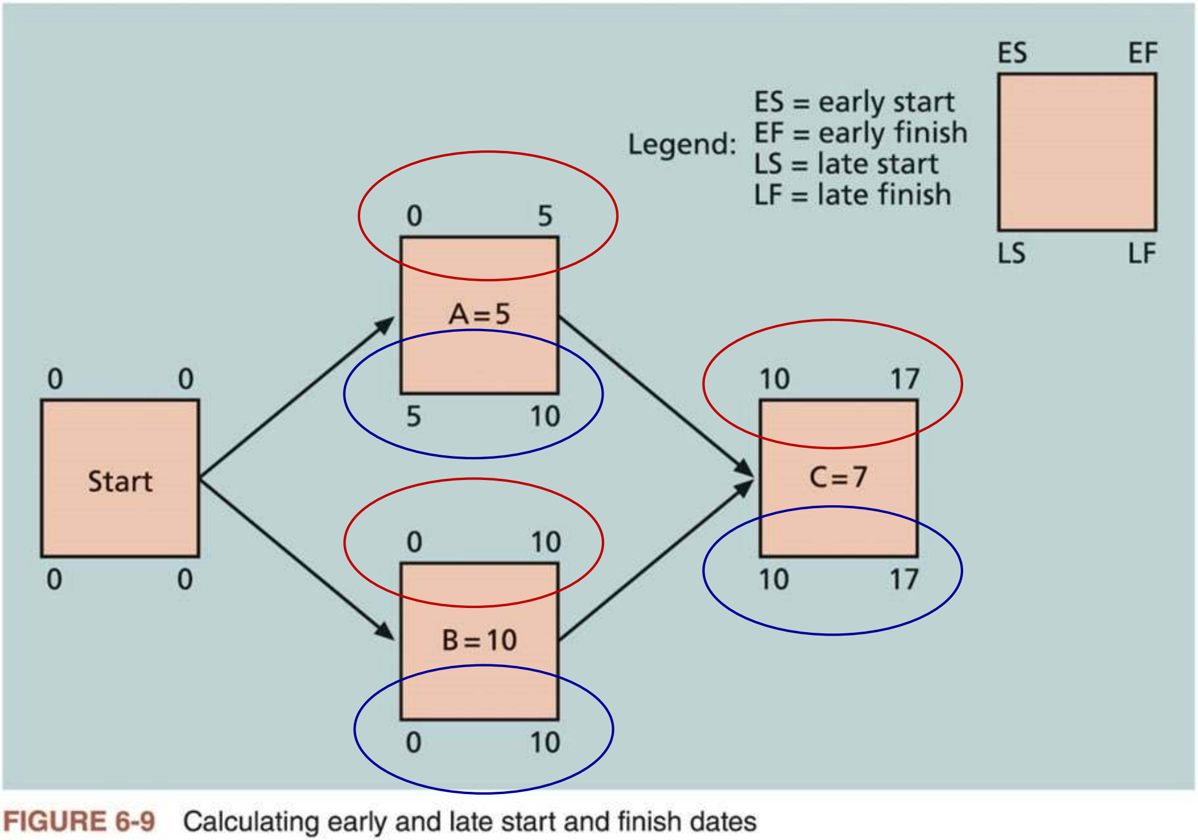
Using Critical Path Analysis to Make
Schedule Trade-Offs (3 of 4)
n Figure 6-9 shows a simple network diagram with EE, EF, LS, and LF for each of the three project activities
No slack on tasks B and C, and both free slack (=ES ofC – EF of A) and total slack (=LF ofA – EF of A) for task A are 5 days
16

Slide 16
Using Critical Path Analysis to Make
Schedule Trade-Offs (4 of 4)
n Table 6-1 shows ES, EF, LS, LF, free slack, and total slack for each of the activities for Project X in Figure 6-4
Task Name | Early Start | Early Finish | Late Start | Late Finish | Free Slack | Total Slack
A | 8/3/15 | 8/3/15 | 8/5/15 | 8/5/15 | 0d | 2d
B | 8/3/15 | 8/4/15 | 8/3/15 | 8/4/15 | 0d | 0d
C | 8/3/15 | 8/5/15 | 8/5/15 | 8/7/15 | 0d | 2d
D | 8/4/15 | 8/7/15 | 8/6/15 | 8/11/15 | 2d | 2d
E | 8/5/15 | 8/11/15 | 8/5/15 | 8/11/15 | 0d | 0d
F | 8/5/15 | 8/10/15 | 8/14/15 | 8/17/15 | 7d | 7d
G | 8/6/15 | 8/13/15 | 8/10/15 | 8/17/15 | 0d | 2d
H | 8/12/15 | 8/19/15 | 8/12/15 | 8/19/15 | 0d | 0d
I | 8/14/15 | 8/17/15 | 8/18/15 | 8/19/15 | 2d | 2d
J | 8/20/15 | 8/24/15 | 8/20/15 | 8/24/15 | 0d | 0d
Table 6-1 Free and Total Float or Slack forProject X
17

Slide 17


Using the Critical Path to Shorten a Project Schedule (1 of 2)
n After knowing the critical path, the project manager can shorten the
duration of activities on the critical path (thereby shortening the project schedule) by allocating more resources to those activities or by changing their scope
n Crashing is a technique for making cost and schedule trade-offs to obtaining the greatest amount of schedule compression for the least incremental cost
Advantage: shorten the time needed to finish a project.
Disadvantage: often increase total project cost.
A B
A B
before crashing
after crashing
18

Slide 18

Using the Critical Path to Shorten a Project
Schedule (2 of 2)
n Fast tracking is another technique which involves doing activities in parallel that you would normally do in sequence
Like crashing, the main advantage of fast tracking is that it can shorten the time needed to finish a project
Disadvantage: it can increase cost and lengthen the project schedule because starting some tasks too soon often increases project risk and results in
rework.
A
A B
B
before fast tracking
after fast tracking
19

Slide 19


Critical Chain Scheduling (1 of 6)
n Critical chain scheduling is a method that considers limited resources when creating a project schedule and includes buffers to protect the project completion date
An application of the Theory of Constraints (TOC), a management
philosophy developed by E. M. Goldratt in his famous books The Goal and Critical Chain
n TOC is based on the metaphor of a chain and its weakest link
Any complex system at any point in time often has only one aspect or constraint that limits its ability to achieve more of the system’s goal
To attain significant improvement, that constraint must be identified and the whole system must be managed with that in mind.
n Three importance concepts
1. Availability of scarce resource
2. Multitasking
3. Time buffers
20

Slide 20

Critical Chain Scheduling (2 of 6)
n Some projects cannot be done unless a particular (scarce) resource is available to work on one or several tasks
For example, if an equipment is needed full time to complete each of two tasks that were originally planned to occur simultaneously, then you must either delay one task or find another equipment to meet the schedule.
n Multitasking occurs when a resource works on more than one task at a time. This situation occurs frequently on projects.
NOT a good thing if you want to finish a project in a timely manner.
Figures 6-10a and 6-10b show how it can delay task completion.
Multitasking also often involves wasted setup time, which increases total duration.
n Critical chain scheduling assumes that resources do NOT multitask or at least minimize multitasking
21

Slide 21
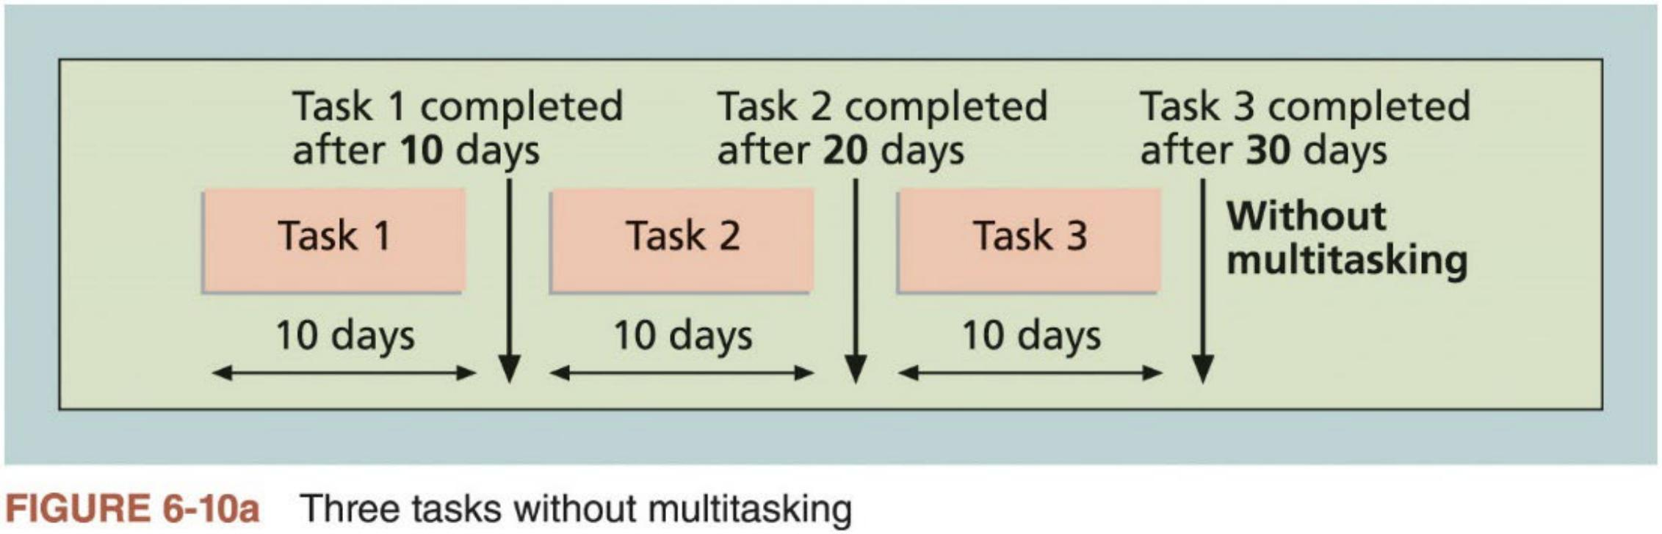
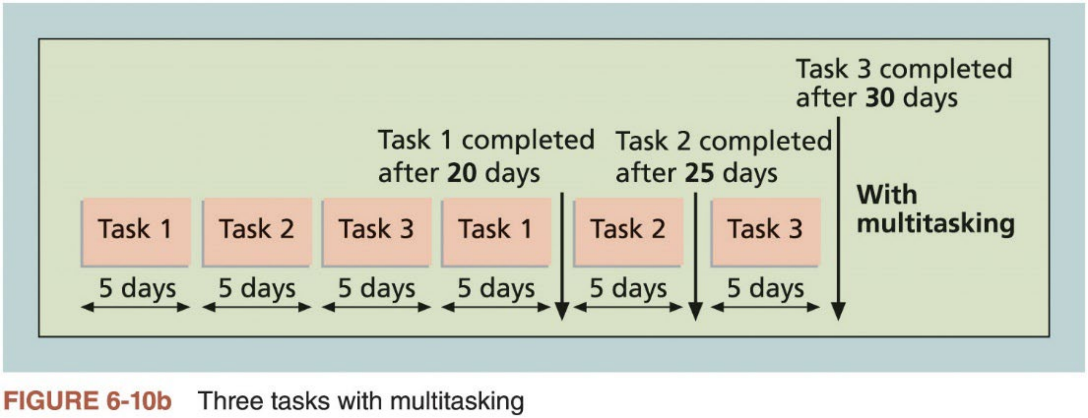
Critical Chain Scheduling (3 of 6)
22

Slide 22
Critical Chain Scheduling (4 of 6)
n Another essential concept of critical chain scheduling is to change the way people make task estimates
Many people add a safety or buffer (i.e., additional time to complete a task) to an estimate to account for various factors
Murphy’s Law: if something can go wrong, it will.
Critical chain scheduling removes buffers from individual tasks and instead creates a project buffer (i.e., add time before the project’s due date).
It also uses feeding buffers to protect tasks on the critical chain from being delayed. Feeding buffers are time added before tasks on the critical chain if they are preceded by other tasks that are NOT on the critical path.
n Figure 6-11 provides an example of a network diagram constructed using critical chain scheduling
23

Slide 23
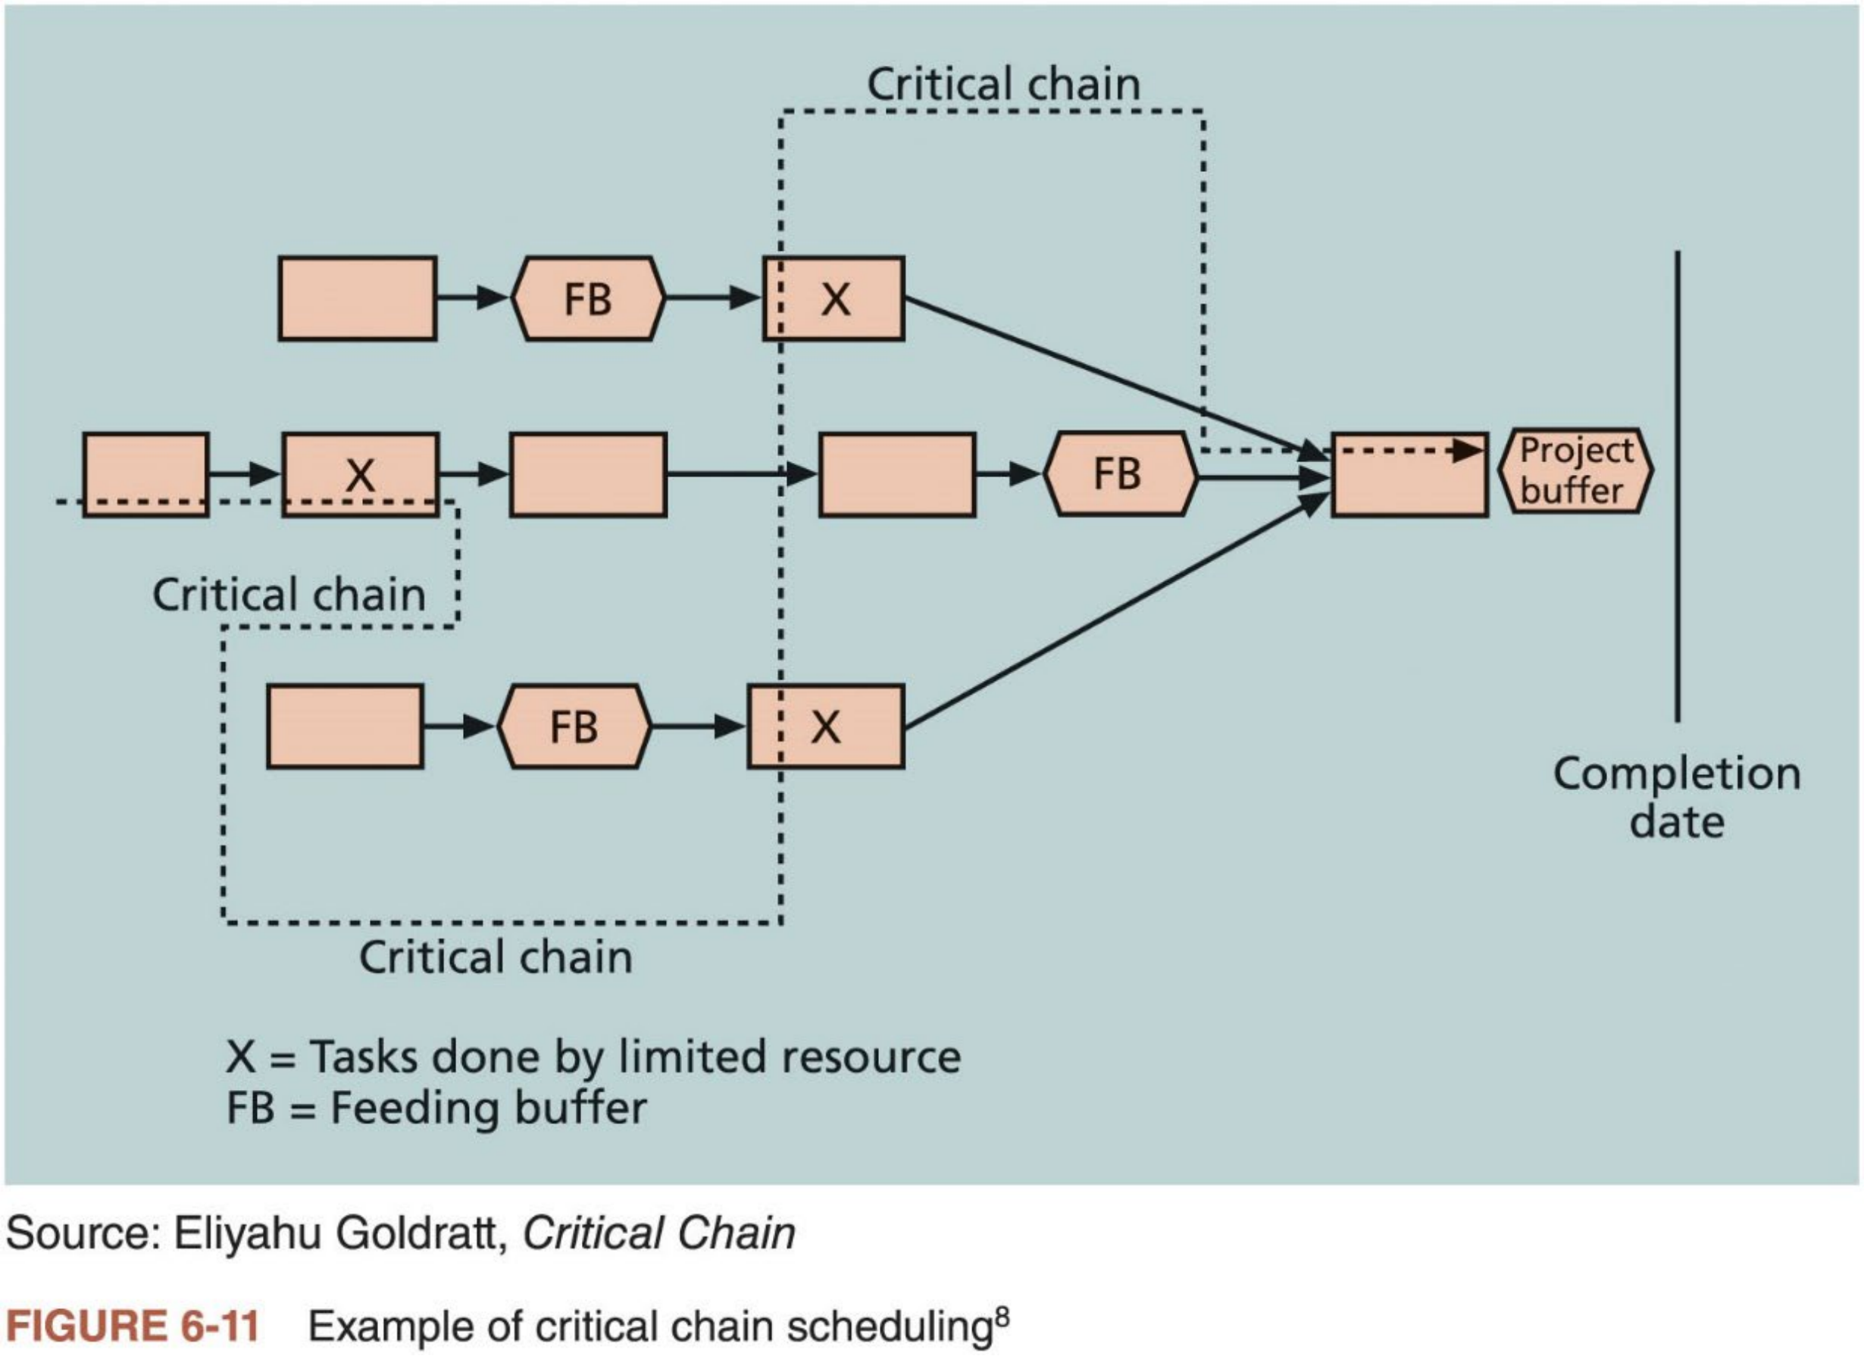
Critical Chain Scheduling (5 of 6)
24

Slide 24

Critical Chain Scheduling (6 of 6)
n The critical chain in Figure 6-11 accounts for a limited resource, X, and the schedule includes the use of feeding buffers and a project buffer in the network diagram
The task estimates in critical chain scheduling should be shorter than traditional estimates because they do not include their own buffers.
Not having task buffers should mean fewer occurrences of Parkinson’s Law: work expands to fill the time allowed.
The feeding and project buffers protect the date that really needs to be met — the project completion date
n Critical chain scheduling is a complicated yet powerful tool that involves critical path analysis, resource constraints, and changes in how buffers
are used as part of task estimates
Some people consider it one of the most important new concepts in the field of project management
25

Slide 25
Program Evaluation and Review Technique
(PERT)
n PERT is a network analysis technique used to estimate project duration when there is a high degree of uncertainty about the individual activity duration estimates
1. Use probabilistic time estimates: duration estimates based on using
optimistic, most likely, and pessimistic estimates of each activity duration, instead of one specific estimate, as CPM does
2. Calculate a weighted average for the duration estimate of each activity using the following formula:
3. Use the weighted average for each activity to perform critical path analysis
n Main advantage: address the risk associated with duration estimates. It may help to develop more realistic schedules.
26

Slide 26
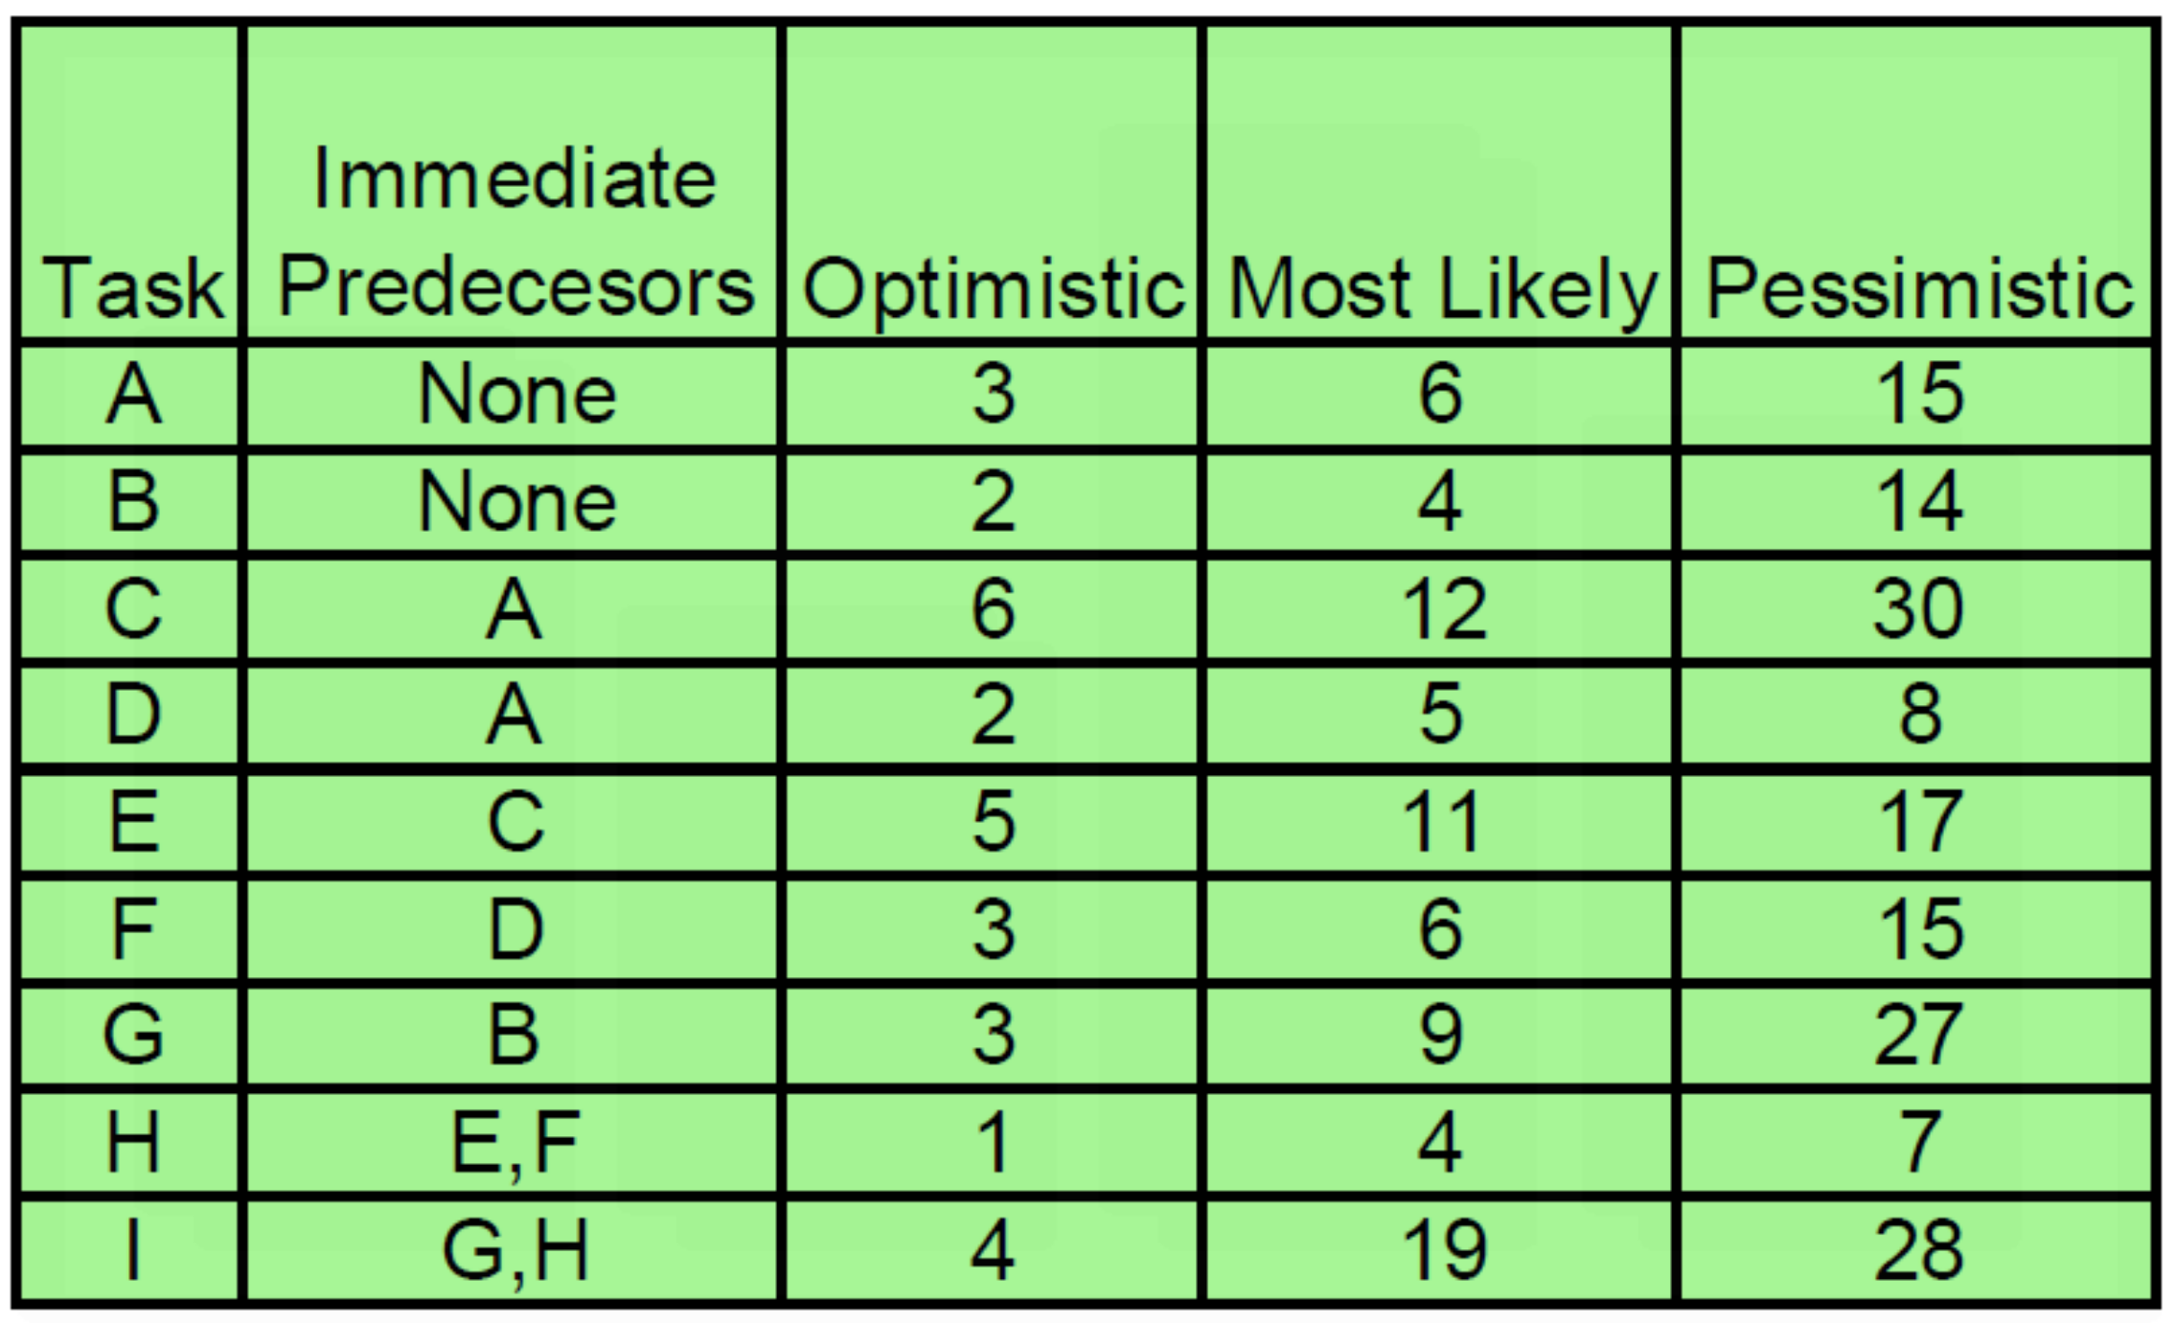
Exercise 4: PERT
n Use PERT to estimate the weighted duration of each task in the following project, and then perform a critical path analysis by drawing a PDM
network diagram.
27

Slide 27
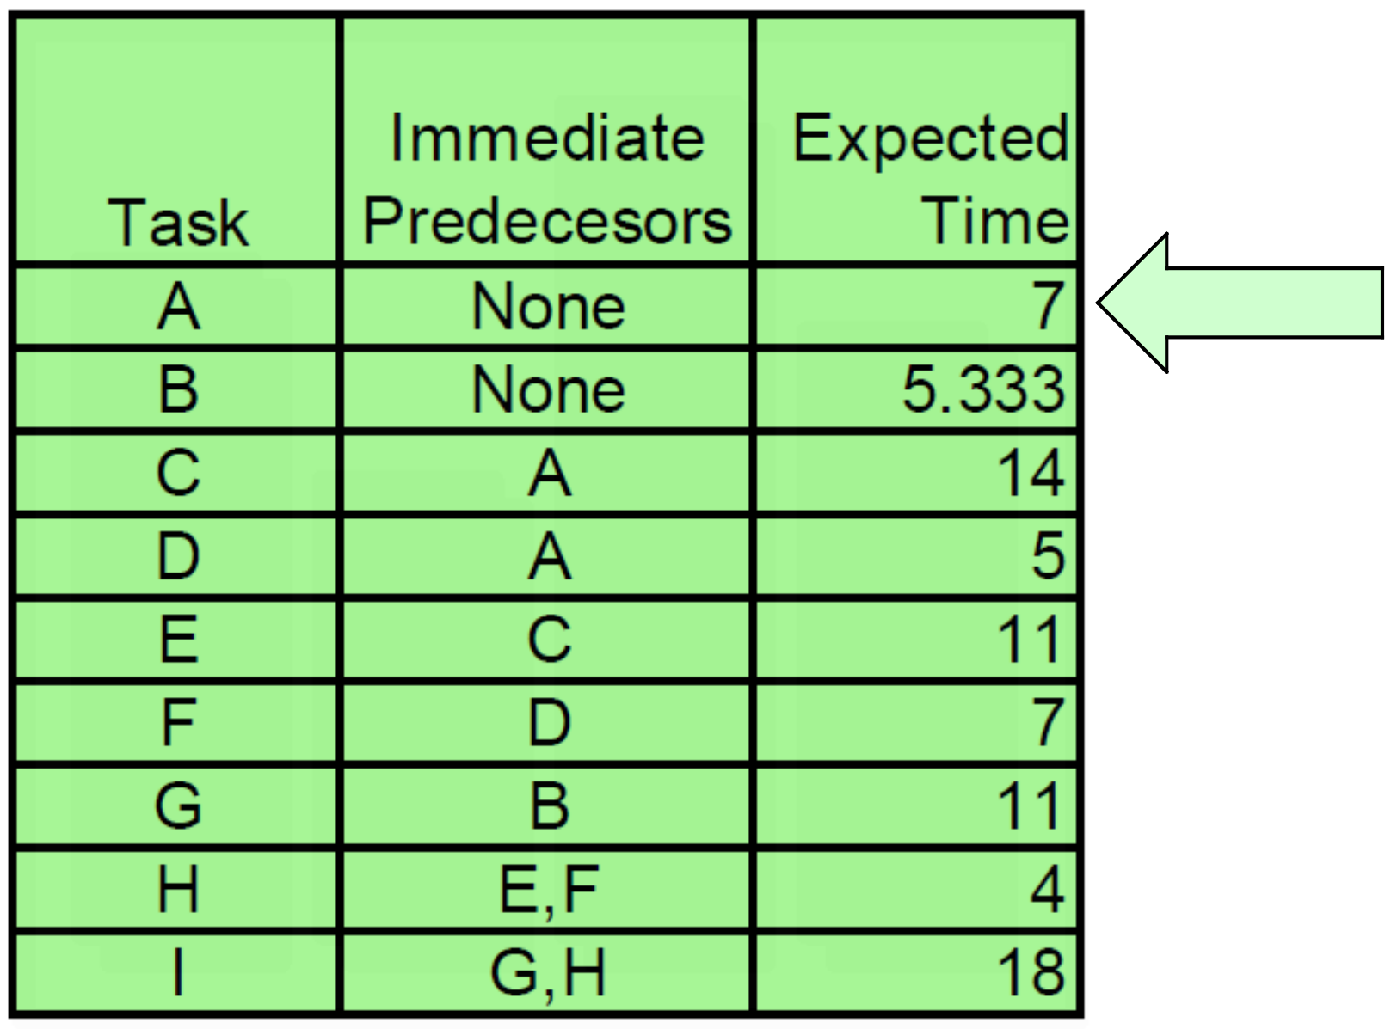
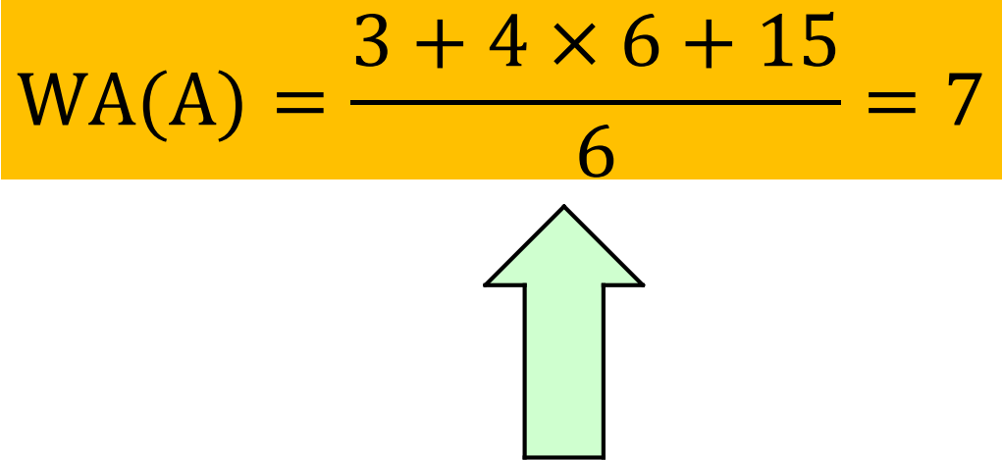
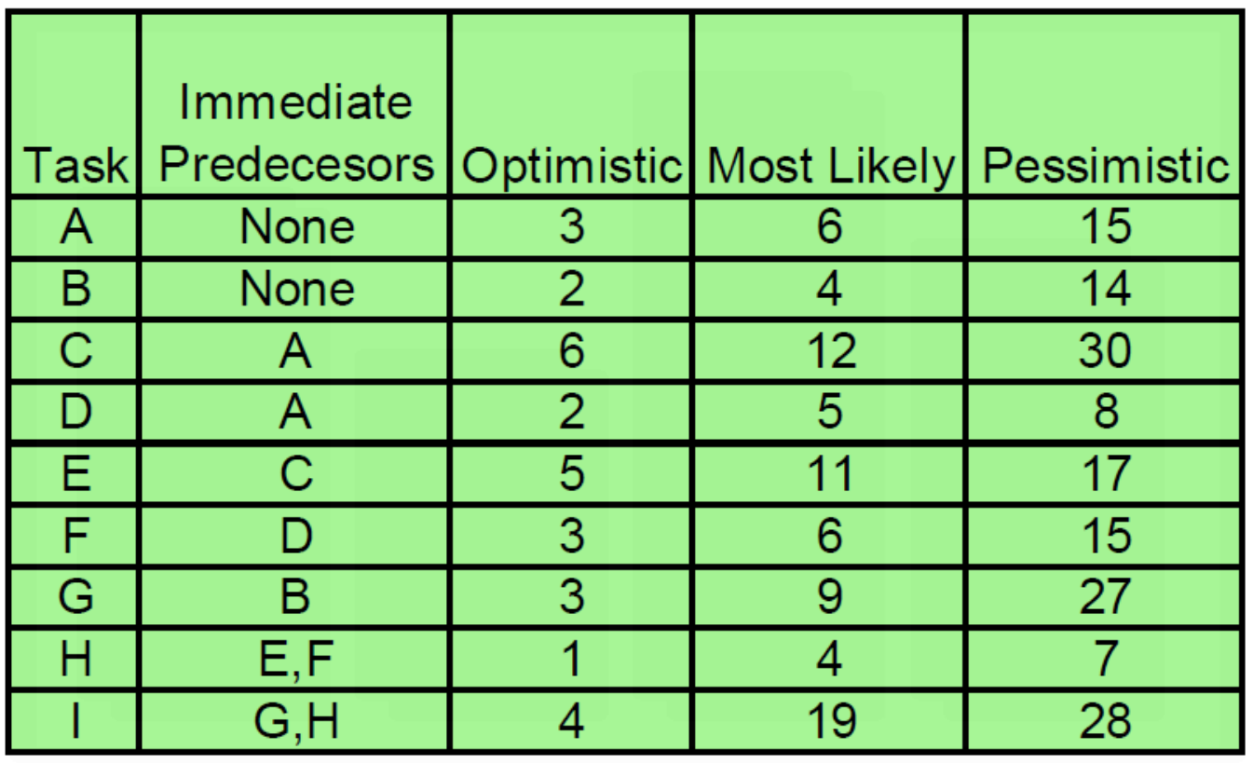
Exercise 4: Solution (1 of 2)
_{Weighted} _{Average} ₌
28

Slide 28
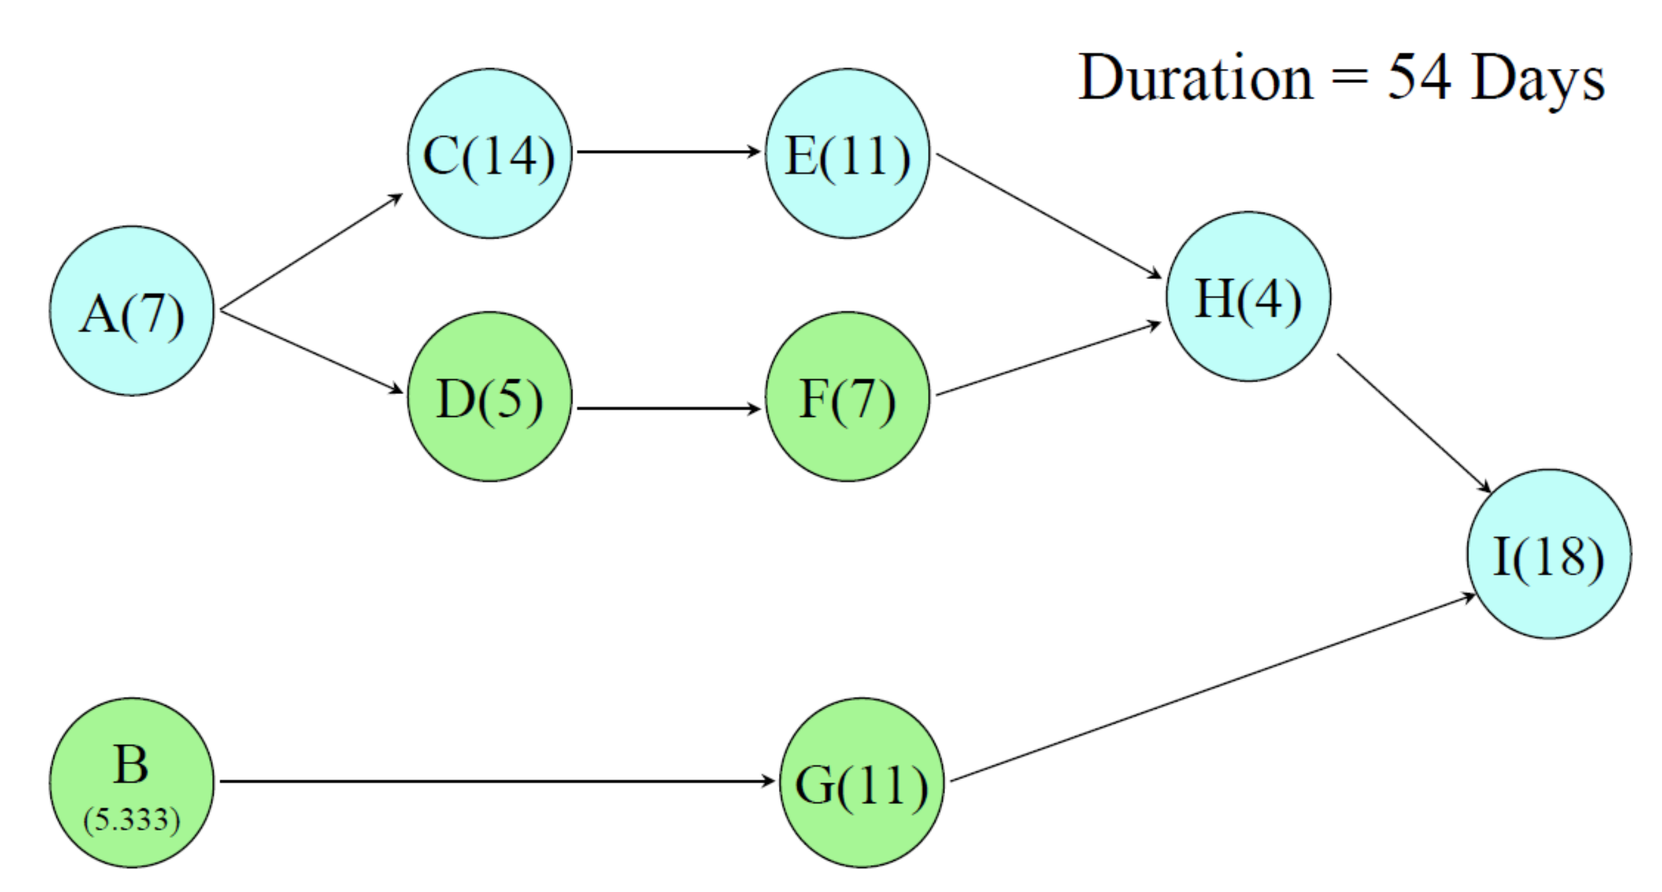
Exercise 4: Solution (2 of 2)
29

Slide 29

6. Controlling the Schedule (1 of 2)
n Like scope control, schedule control is a part of the integrated change control process in project integration management
n Goals of schedule control
i. Know the status of the schedule
ii. Influence the factors that cause schedule changes
iii. Determine that the schedule has changed
iv. Manage changes when they occur
n Main outputs
Work performance information, schedule forecasts, change requests, PM plan updates, and project documents updates
n Many issues are involved in controlling project schedules
Important to ensure the project schedule is realistic and use discipline and leadership to emphasize the importance of following and meeting project schedules
30

Slide 30
6. Controlling the Schedule (2 of 2)
n Project managers must handle personnel-related issues to keep projects on track
“Most projects fail because of people issues, not from failure to draw a good
PERT chart.”
n Several soft skills for project managers to control schedules
i. Review the draft schedule usually included in the project charter
ii. Prepare a more detailed schedule with the project team and get the approval from key stakeholders
iii. Review the actual work and develop a good relationship with team
members to ensure work is completed as planned or changes are reported as needed
iv. Alert top management and work with them to resolve the conflicts, when serious conflicts arise that could affect the project schedule
v. Use discipline to control project schedules. Insist that important schedule dates be met and proper planning and analysis be completed up front
31

Slide 31
Using Software to Assist in Project Schedule Management
n Project management software such as Microsoft Project was designed specifically for performing project management tasks
i. Many projects involve hundreds oftasks with complicated dependencies.
After you enter the necessary information, the software automatically generates a network diagram and calculates the critical path(s) for the project. It also highlights the critical path on the network diagram.
ii. It calculates the free and total float or slack for all activities. Using it
eliminates the need to perform cumbersome calculations manually and
allows for “what if” analysis as activity duration estimates or dependencies change.
iii. It easily creates Gantt charts and tracking Gantt charts, which make it easier for project teams to track actual schedule performance versus the planned or baseline schedule.
iv. It also includes many built-in reports, views, and filters to assist in project schedule management.
32

Slide 32



Words of Caution on Using PM Software
n Understanding the underlying concepts is critical to successful use of PM software, as is understanding the specific needs of your project
Many people misuse PM software because they do not understand the
concepts behind creating a network diagram, determining the critical path, or setting a schedule baseline.
n To use any software effectively, users must have adequate training in the software and an understanding of its concepts and capabilities
n Users should be careful not to rely too much on templates or sample files and ignore the unique concerns of their projects
There are benefits to using template files, such as less setup time and a
reality check if the project manager has never led a certain type of project before.
There are also drawbacks, because many assumptions made in these template files might not apply to their projects.
33

Slide 33

Complementary Reading
n Chapter 6 “Project Schedule Management” of Schwalbe (2018)
n Chapter 6 “Project Schedule Management” in Part 1 of PMBOK® Guide (2017)
n Dr. Kathy Schwalbe’s webpage for Microsoft Project
A Brief Guide to Microsoft Project Professional 2016
34

